Slide 1
Phillip T Slee (Ph.D) Grace Skrzypiec (Ph.D)
John Mannion Chris McDermott

Slide 2
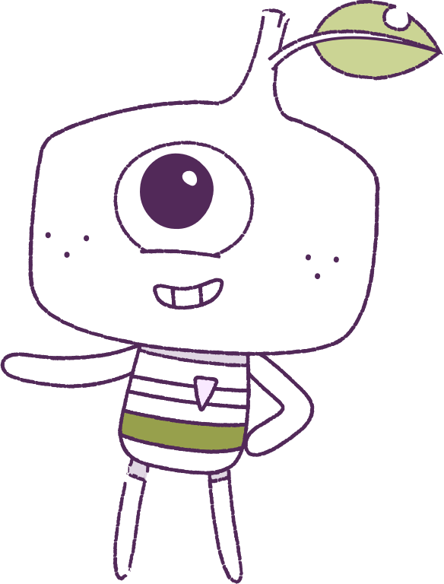
Lesson 3
Exclusion and Relationships
Lesson aims:
1.
Understand social exclusion.
2.
Explore friendships and relationships.
3.
Understanding bullying.
Notes:
EQUIPMENT REQUIRED Student drawings can be used as a handout or shown on powerpoint, materials to create a group discussion ie butcher paper
CORE CONTENT PART 1: Understanding Social Exclusion. PART 2: Exploring friendships and relationships. Teachers select activities suitable for the developmental age of the students. PART3: Bullying.
COPING STRATEGY Be a good friend

Slide 3
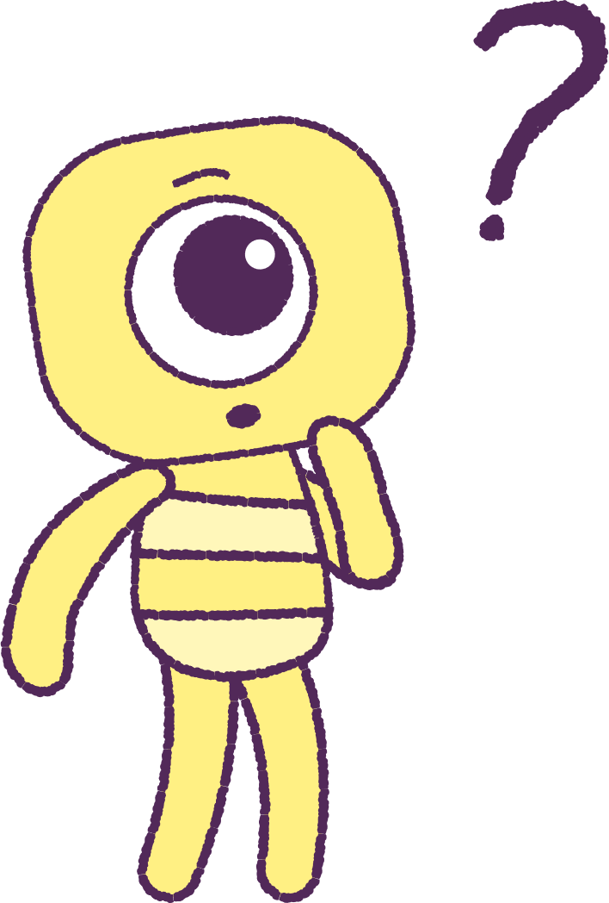
Part 1 – Review content from last week
Who can remember what we discussed last week?
In our session today, we will talk more about relationships.
Lets get ready to look at the animation!
3
Notes:
Begin by reviewing what they remembered from last week about emotions and feelings.
In the lesson today we will talk more about relationships– lets begin by looking at the animation.

Slide 4
Part 2 – Watch the animation
4
Hover your mouse over the video to view play settings. Otherwise, download from the website.
Notes:
Show the digital animation as a lead in to the lesson on Exclusion & Relationships
Researchers have distinguished friendships from acceptance by the peer group, although both involve likeability. The main difference is that friends reflect private relationships that are generally marked by an egalitarian friendship status. Often these friendships are formed on the basis of idiosyncratic criteria, such as shared interests or traits. Peer groups, on the other hand are publicly known and have easily identified and valued group characteristics. Friendships serve the purpose of companionship, intimacy, support, reliable alliance, self-validation and emotional security. Several research studies have shown that young people who lack friendships experience maladjustment and mental health difficulties. (Slee & Skrzypiec, 2016 ;). Friendship – just having one good friend – is a buffer against bullying. (Skrzypiec, Slee, Askell-Williams & Lawson, 2012).

Slide 5
Question Time
Let’s brainstorm about the animation.
How do we think the peeps are feeling?
What do we think the feels are feeling?
How about…
• In the beginning?
• In the middle?
• In the end?
5
Notes:
Recommended to re-watch the animation a few times as a class.
Young people’s healthy development is heavily dependent on good, positive relationships, and in turn, healthy development is a critical component for the development of young people’s positive relationships. Irrespective of the life stage, relationships are central for each individual’s social, emotional and cognitive growth and well-being.

Slide 6
Part 3 – Watch the animation
6
Hover your mouse over the video to view play settings. Otherwise, download from the website.
Notes:
Show the digital animation as a lead in to the lesson on Exclusion & Relationships
Researchers have distinguished friendships from acceptance by the peer group, although both involve likeability. The main difference is that friends reflect private relationships that are generally marked by an egalitarian friendship status. Often these friendships are formed on the basis of idiosyncratic criteria, such as shared interests or traits. Peer groups, on the other hand are publicly known and have easily identified and valued group characteristics. Friendships serve the purpose of companionship, intimacy, support, reliable alliance, self-validation and emotional security. Several research studies have shown that young people who lack friendships experience maladjustment and mental health difficulties. (Slee & Skrzypiec, 2016 ;). Friendship – just having one good friend – is a buffer against bullying. (Skrzypiec, Slee, Askell-Williams & Lawson, 2012).

Slide 7
Question Time
• What do you think is happening here?
• How might the peep be feeling? • Why do you think Twig doesn’t
want Steg to play? • Is Fin playing fair?
7
Notes:
Recommended to re-watch the animation a few times as a class.
Young people’s healthy development is heavily dependent on good, positive relationships, and in turn, healthy development is a critical component for the development of young people’s positive relationships. Irrespective of the life stage, relationships are central for each individual’s social, emotional and cognitive growth and well-being.

Slide 8
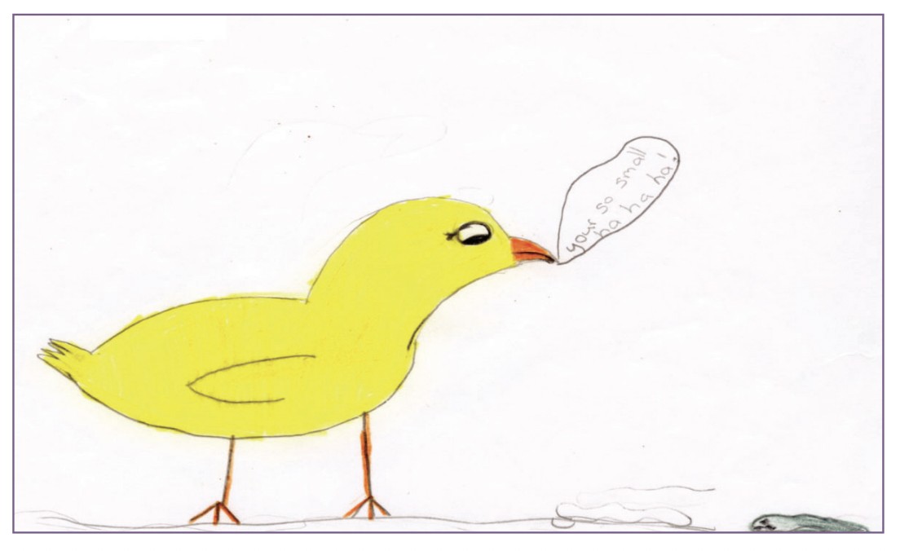
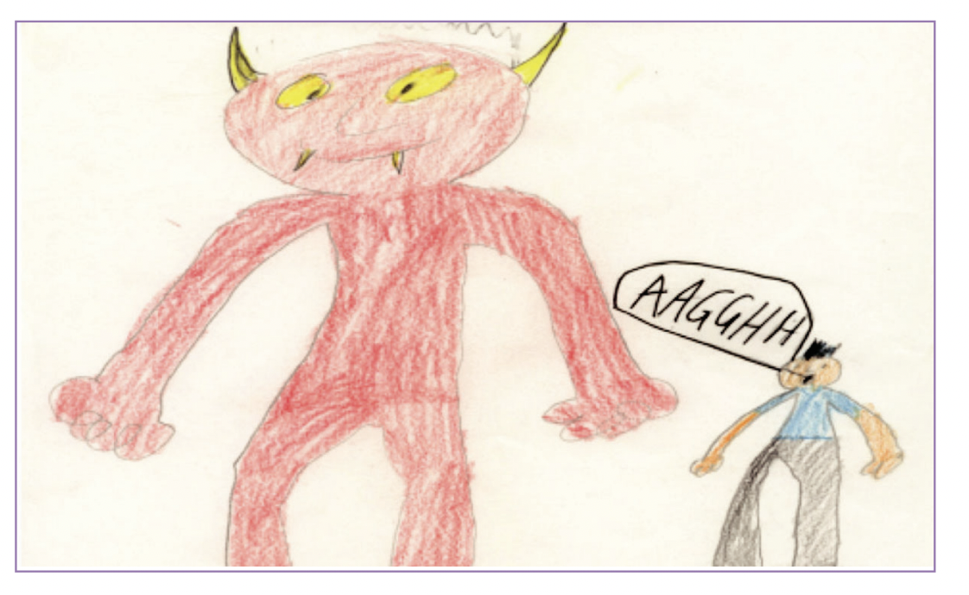
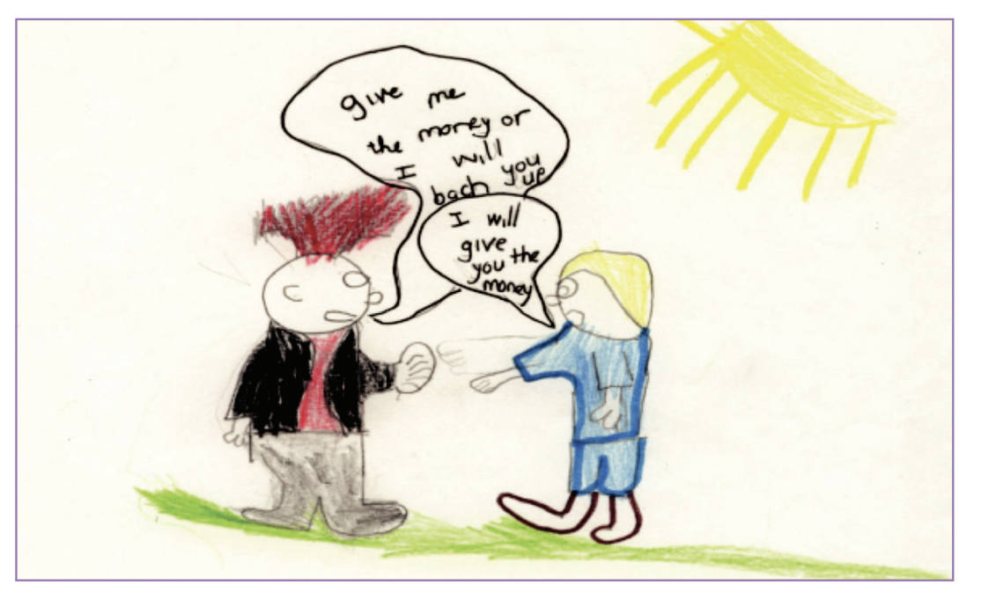
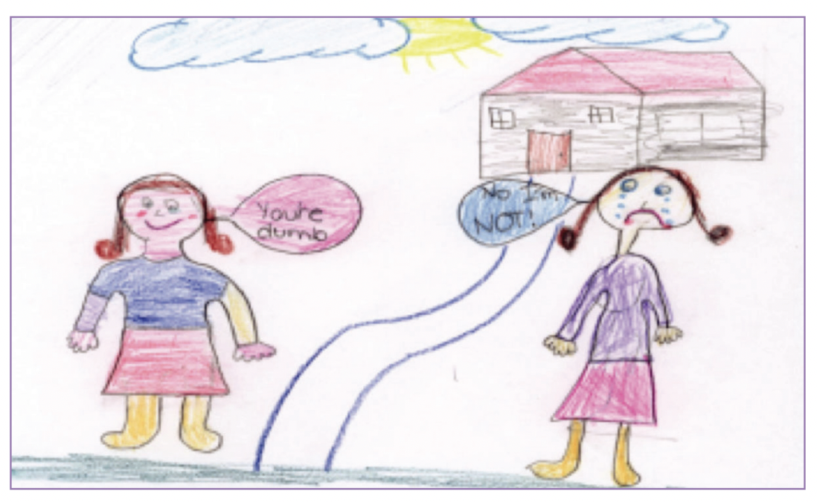
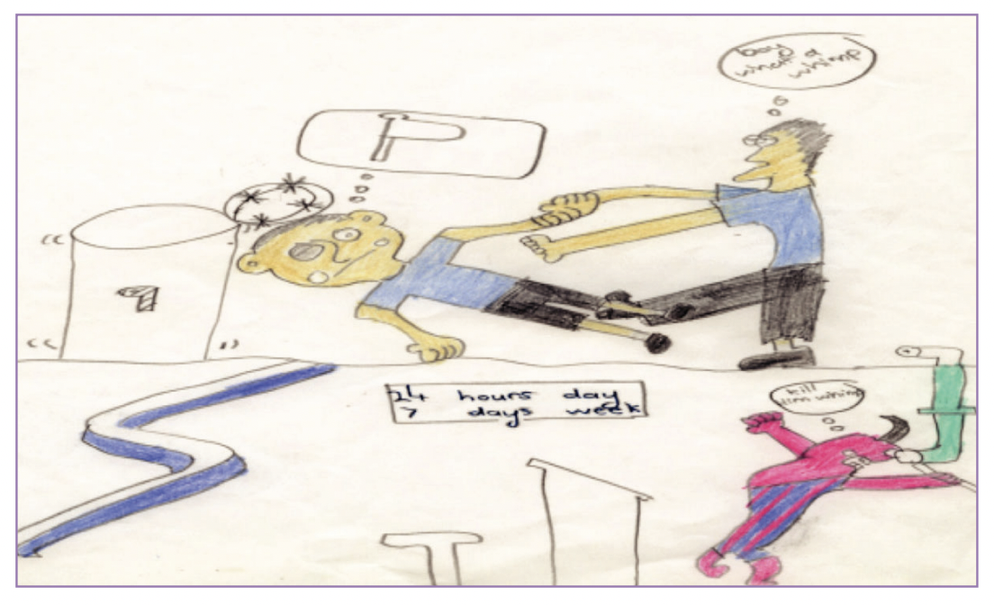
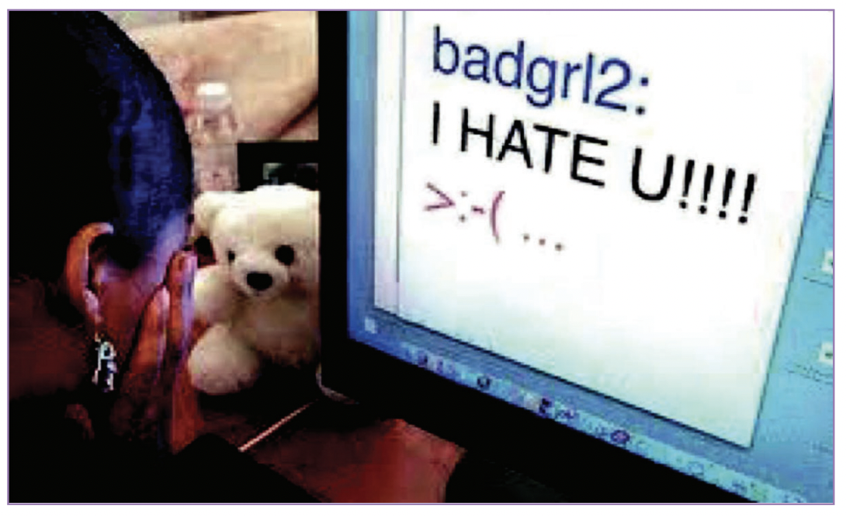
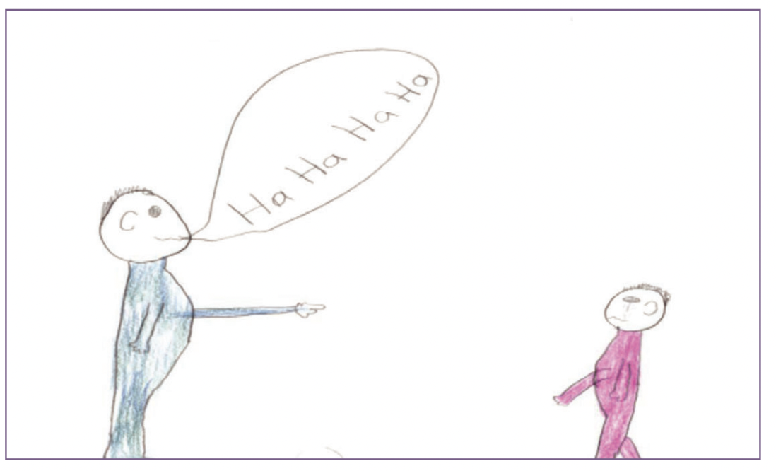
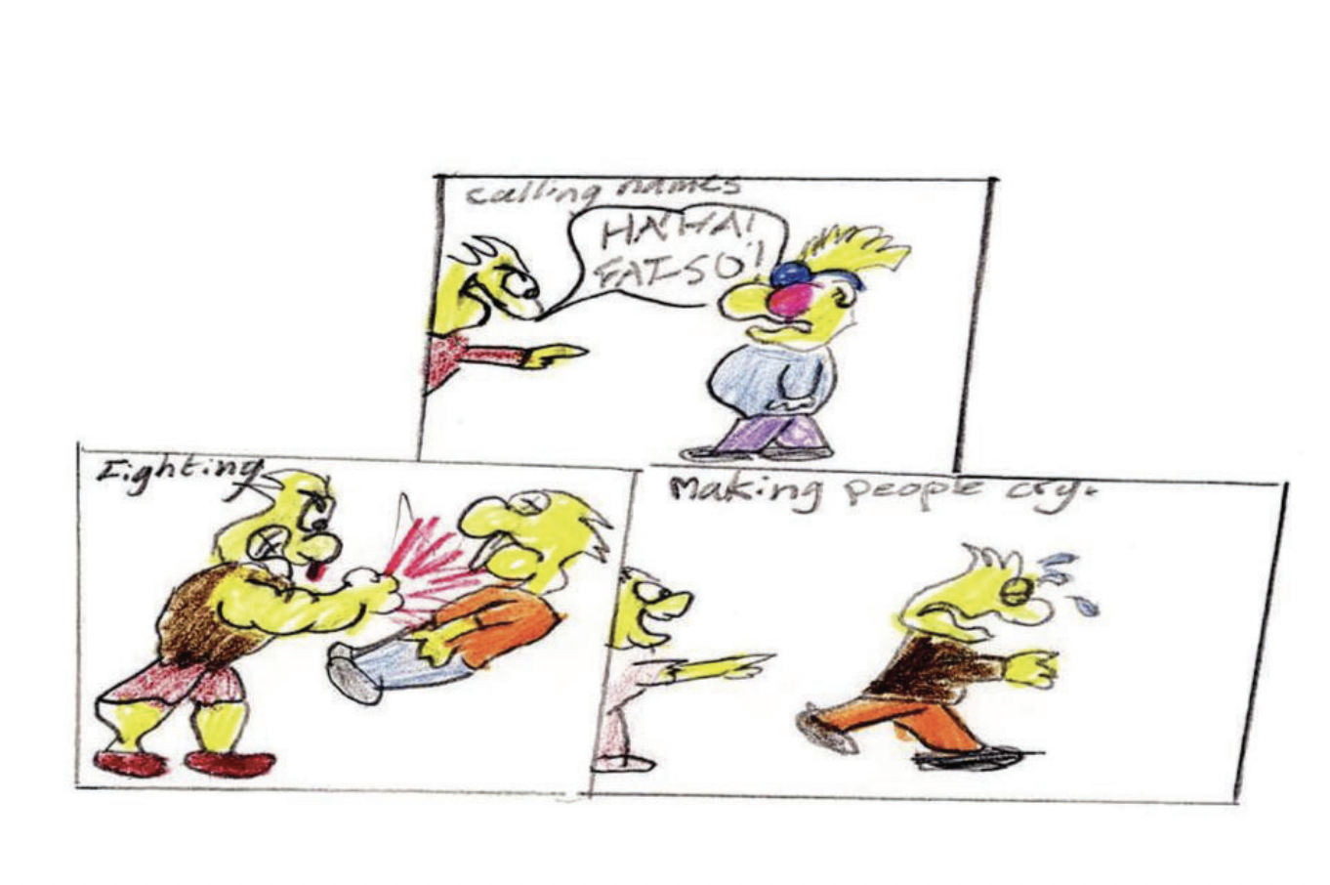
Part 4 – Discuss the Student Drawings
In groups, have a look at the student drawing printouts and discuss them. What does bullying look like? How are the children feeling? What could you do if you saw this happening? What could the school do? How can we solve these problems?
8
Notes:
Students work in groups to discuss bullying by exclusion and other forms of bullying e.g. physical, verbal, cyber. Show the student drawings - bullying by exclusion.
Bullying is: • Typically repeated. • Deliberately harmful. • Involves the systematic abuse of power. Types of bullying include physical, verbal, social and cyber.
Teacher notes:
Ask children what they see happening in the drawings.
How are the children feeling?
What could you do if you saw this happening?
What could the school do?
How do we solve problems like this in our classroom/school yard? Optional teaching activities: Children role play solutions to the scenario. Children in pairs or groups discuss solutions. Generate and post a list of solutions e.g. “Tell the person to stop” – “talk to a trusted adult” – “ask a friend to tell the person to stop” etc.

Slide 9
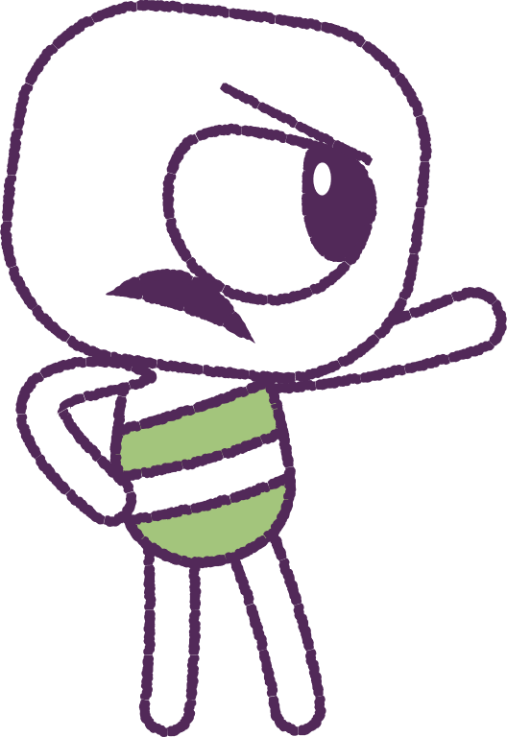
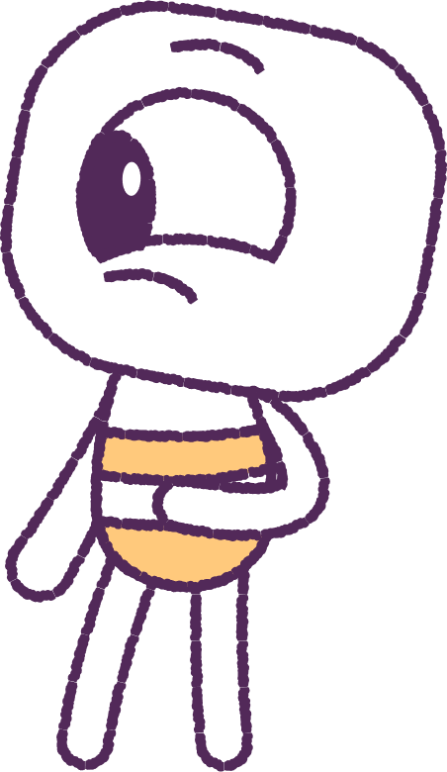
Optional Activities
In groups, continue to look at your student drawing printouts. And afterwards…
• Pick a drawing, and roleplay the situation.
• Pick a drawing, and discuss solutions.
9

Slide 10
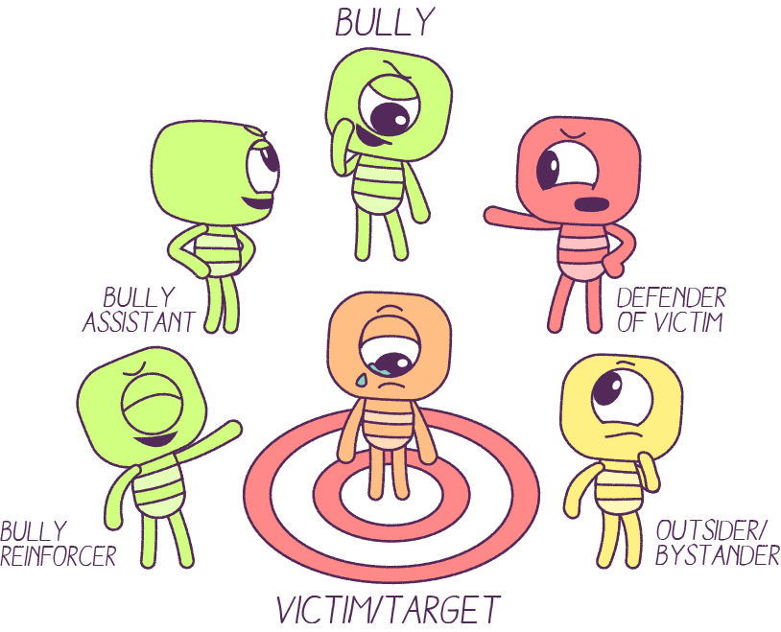
More Discussion
What roles do we play in any bullying scenario?
Let’s discuss/role play what you could do if you witnessed bullying.
Learning about this will help you manage real scenarios.
10
Notes:
Class discussion could involve a Y chart - social exclusion looks like - feels like - sounds like.
Identifying the role of friendship in addressing school bullying e.g. as a protective factor.
Role play is a powerful way to have students feel better prepared in real world scenarios

Slide 11
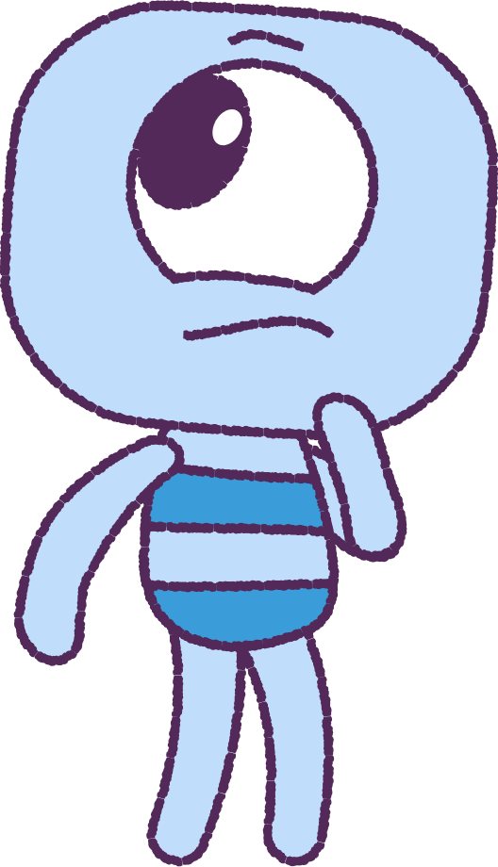
To summarise, bullying is…
• Typically repeated.
• Deliberately harmful.
• Involves the systematic abuse of power.
Types of bullying include:
• Physical
• Verbal
• Social
• Cyber
11

Slide 12
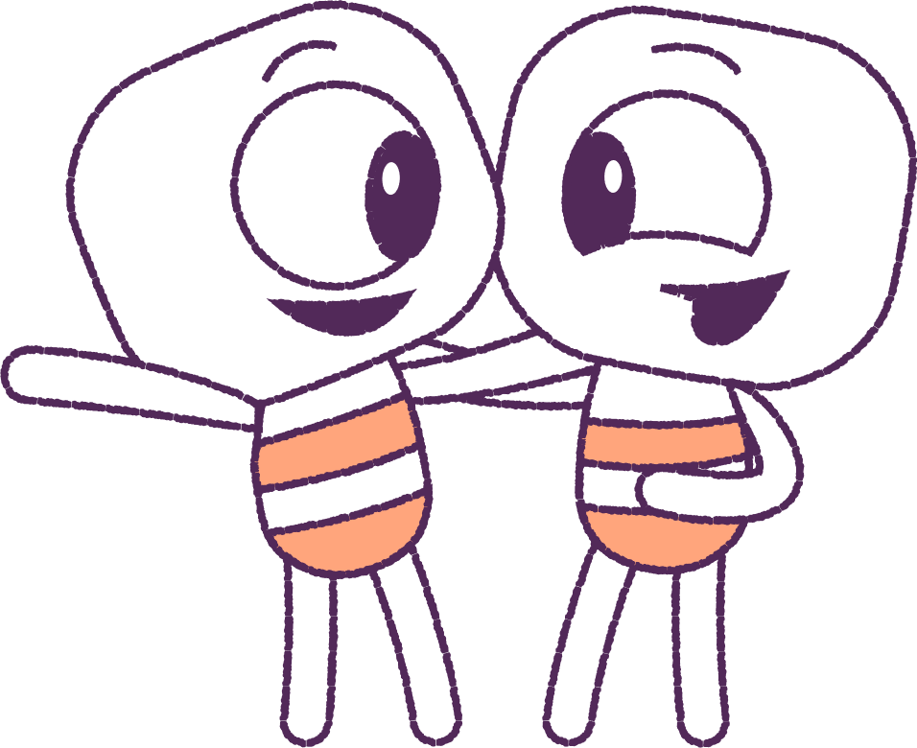
Part 5 - Activities
Next, we will explore more class activities relating to friendships.
12

Slide 13
Activity – Friendship Sayings
Let’s find a variety of common friendship quotes and discuss their meaning.
• Walking with a friend in the dark is better than walking alone in the light.
• A best friend is like a four leaf clover; hard to find, lucky to have.
• As your best friend I’ll always pick you up when you fall, after I finish laughing.
• Never let your best friends get lonely... keep disturbing them.
13
Notes:
Students could individually or in pairs find a quote and explain it’s meaning

Slide 14
Activity - What is a Friend?
In groups, answer one of these questions.
• What makes a good friend?
• What are the advantages of having friends?
• What are some ways to make new friends?
• What are some ways to keep friends?
• What gets in the way of friendships?
• How could a friend support some - one who was being bullied?
14

Slide 15
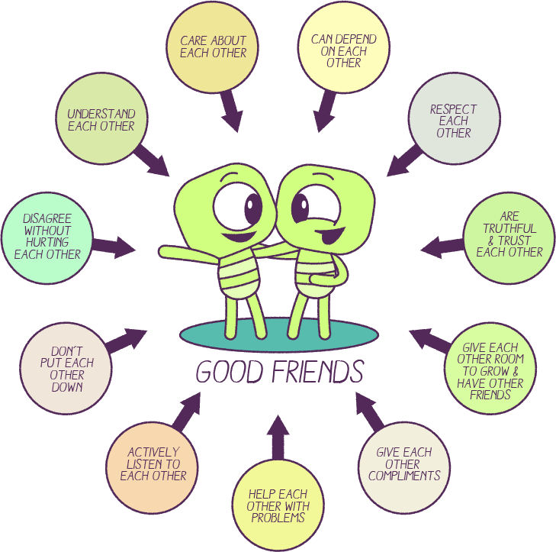
Activity - Good friends
A good friend will respect you, understand you, care about you, and more.
Examine the diagram on
the right to understand more about what it’s like to be (or have) a good friend.
15

Slide 16
Activity – Word Search
Complete the wordsearch handout.
Discuss the words with friends as you find them.
16
Notes:
OPTION Give students the Handout on Good Friends OR the “Good Friends” word search.

Slide 17
This is the end of Lesson 3.
Great work!

