Slide 1
Phillip T Slee (Ph.D) Grace Skrzypiec (Ph.D)
John Mannion Chris McDermott

Slide 2
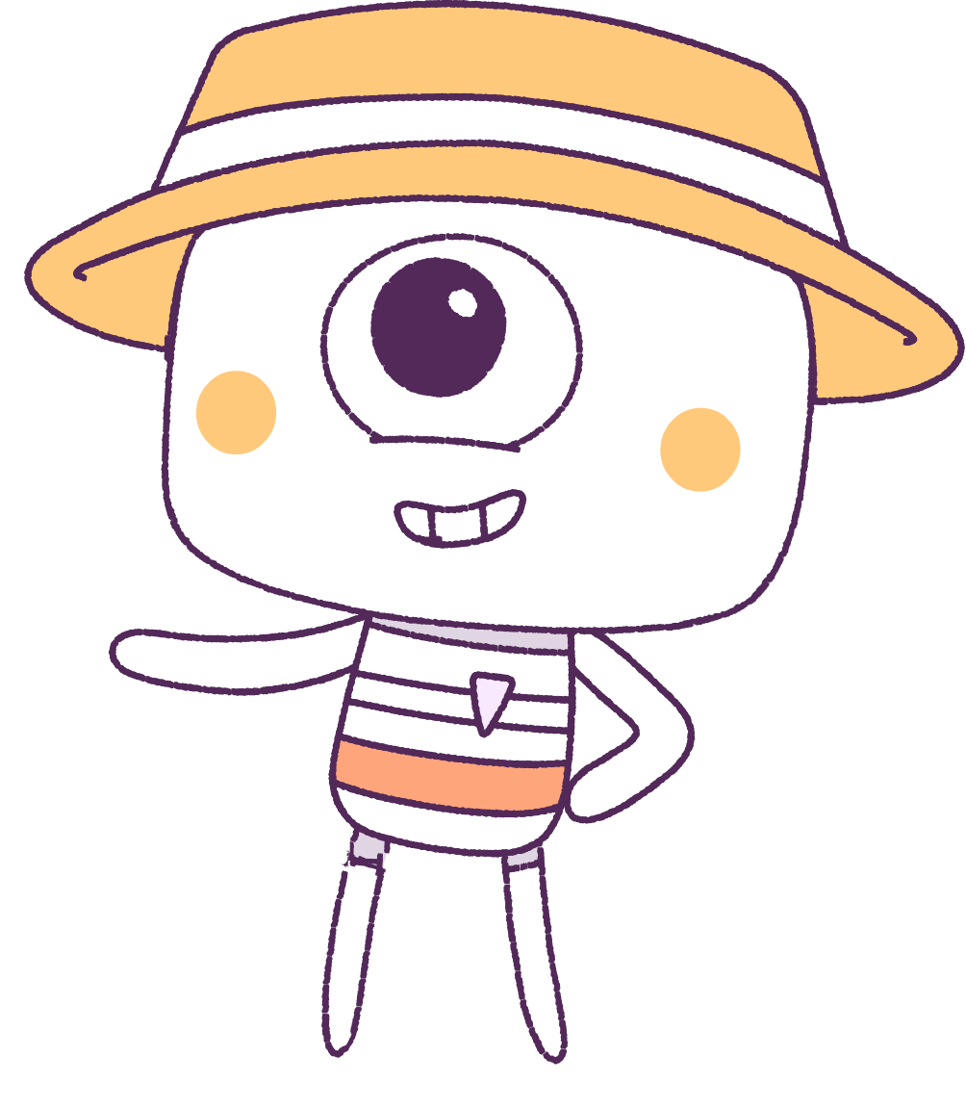
Lesson 2
Emotions
Lesson aims:
1.
Discover more about recognising different types of emotions.
2.
Discover emotion management strategies.
Notes:
Introduction
Emotions – discussion of emotions and managing emotions.
General Capability
Personal and social; ethical understanding.
Equipment Required
Access to the digital animation: “Ice-cream”
*Art resources to create the emotion meter or the egg faces
Core Content
PART 1: Comprehending emotions and learning to express as well as regulate them.

Slide 3
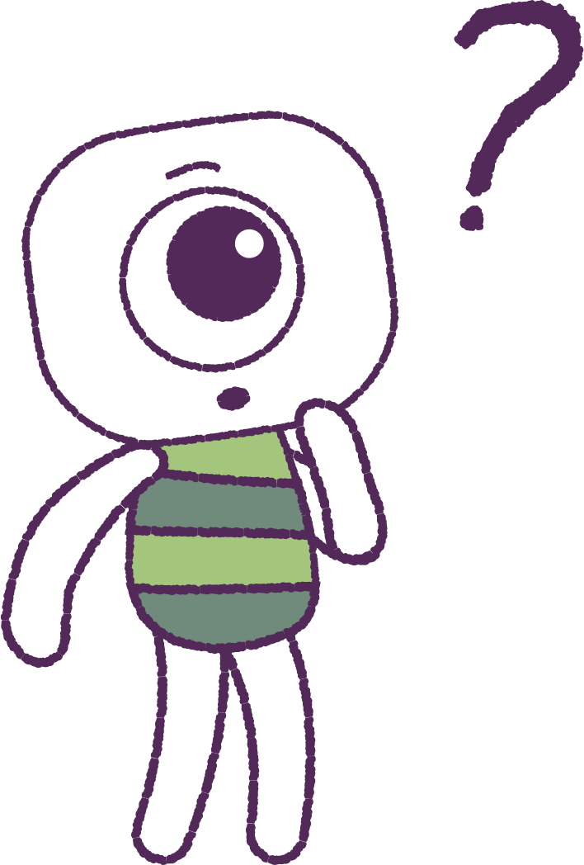
Part 1 – Review content from last week
Who can remember what we discussed last lesson in our groups?
In our session today, we will talk more about emotions and feelings.
Lets get ready to look at the animation!
3
Notes:
Begin by reviewing what they remembered from last week about emotions and feelings.
In the lesson today we will talk more about emotions and feelings – lets begin by looking at the animation.

Slide 4
Part 2 – Watch the animation
Hover your mouse over the video to view play settings. Otherwise, download from the website.
4
Notes:
Show the digital animation as a lead in to the lesson on emotions.

Slide 5
Question Time
Now we will brainstorm about the animation.
How is the peep feeling having dropped his icecream?
Which of these feelings are positive emotions?
Which of the feelings are negative emotions?
5
Notes:
Research demonstrates that children can be effectively taught coping skills if they have learnt to self-regulate their emotions. This is particularly important for children who have experienced trauma and may try to cope by becoming submissive/aggressive or using avoidance behaviours. Emotions are a vital part of our everyday lives, and the highs and lows experienced can significantly affect well-being. Assisting young people in managing their emotions is the first step in helping them cope.
Have students brain-storm as a class how the “peep” is feeling having dropped the ice-cream. Consider both positive and well as negative feelings (e.g., I can now go and get the flavour I really wanted or disappointment for having had just a small amount before it fell).

Slide 6
Part 3 - Activities
Next, we will explore class activities relating to emotions and feelings.
6

Slide 7
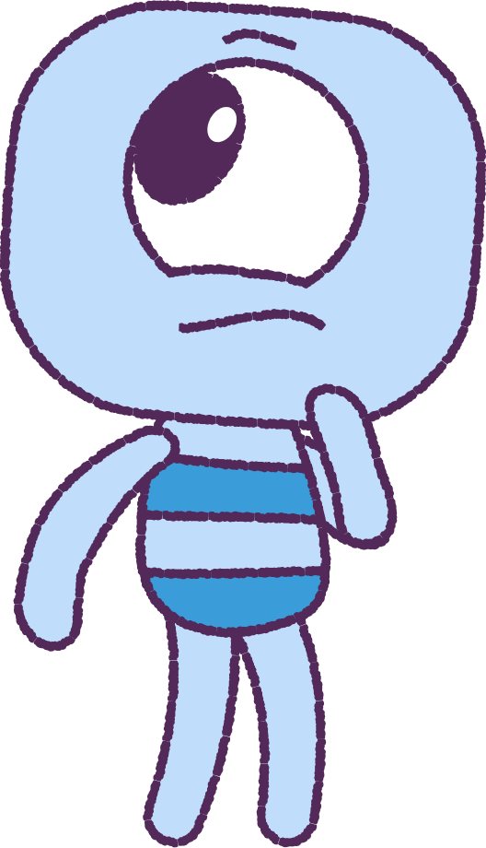
Activity - Easter Egg
Draw a variety of faces on plastic Easter Eggs.
The top half should have eyes.
The bottom half should have mouths.
Discover and talk about different emotions, as students interchange the parts and make different faces.
7

Slide 8
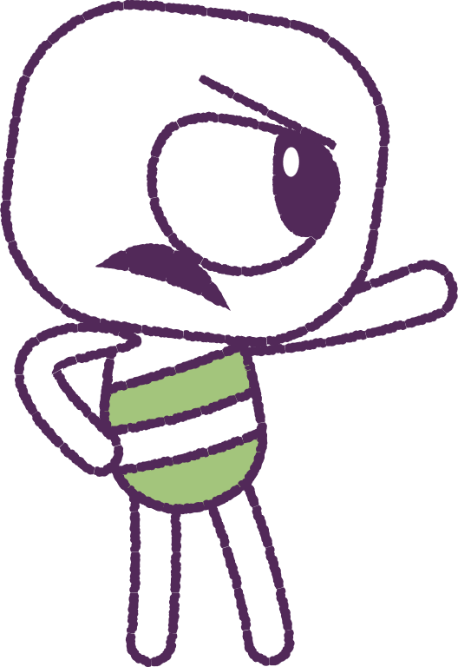
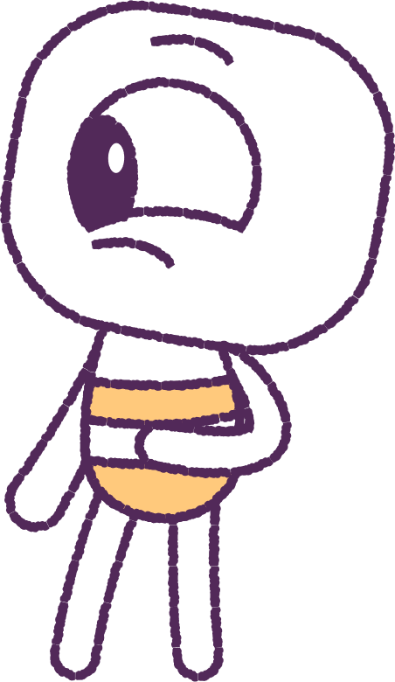
Activity – Books About Feelings
Your teacher will now read a book, related to feelings and emotions.
After listening to the story, identify and discuss any emotions or feelings the characters worked through.
8

Slide 9
Activity - Teaching Feeling Words
Discuss - what are some feeling words?
For example:
Happy
Sad
Mad
Can you think of any others?
9

Slide 10
Activity - The Feelings Song. Discuss the feelings.
10

Slide 11
Activity - The Emotions Song. Discuss the emotions.
11

Slide 12
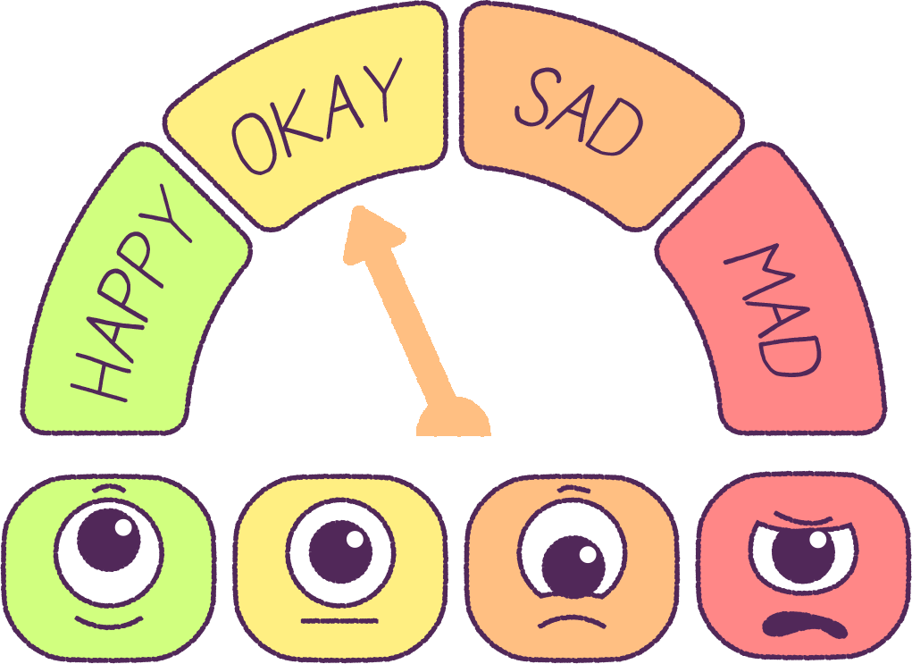
Activity - Emotion Meter
Activity - Anger Meter
Create your own emotion meter.
Create your own anger meter.
12
Notes:
Empower younger students to express themselves with an emotion meter. This is a great tool to use with students who may not yet be able to clearly express what mood they are in.
Empower younger students to express themselves with an anger meter. This is a great tool to use with students who may not yet be able to clearly express what mood they are in.
Have students create their own.

Slide 13
Activity - Soles of the feet mindfulness exercise – Part 1
1
If you are standing, stand in a natural rather than an aggressive posture, with the soldes of your feet flat on the floor.
If you are sitting, sit comfortably with the soles of your feet flat on the floor.
Breathe naturally, and do nothing.
Cast your mind back to an incident that made you very angry. Stay with
that anger.
You are feeling angry, and angry thoughts are flowing through your mind. Let them flow naturally, without restriction. Stay with the anger. Your body may show signs of anger. (e.g., rapid breathing).
Now, shift all your attention to the soles of your feet.
2
3
4
5
6
13
Notes:
“Soles of the Feet Mindfulness Exercise”. Nirbhay Singh and his colleagues point out that: The procedure, termed Soles of the Feet, enables the individual to divert attention from an emotionally arousing thought, event, or situation to an emotionally neutral part of one’s body. The individual is able to stop, focus the mind back on the body, calm down and then make a choice about how to react to the thought, event, or situation that triggered the arousal response. Once the procedure is mastered to the point of automaticity, the individual can use it in multiple contexts, whether sitting, standing or walking slowly. It provides the individual with an internalized response that is easy to master and can be accessed in almost any situation.
SKILL Controlling the urge to be physically or verbally aggressive.
RATIONALE When an incident occurs or a situation arises that typically makes you angry and you feel like either verbally threatening or hitting someone, it is important to control these feelings. We try not to threaten or hurt people when we disagree with them. This is a simple way of quickly calming yourself.

Slide 14
Soles of the feet mindfulness exercise – Part 2
7
Slowly, move your toes, feel your shoes covering your feet, feel the texture of your socks or hose, the curve ofyour arch, and the heels of your feet against the back of your shoes. If you do not have shoes on, feel the floor or carpet with the soles of your feet.
Keep breathing naturally and focus on the soles of your feet until you feel calm.
Practice this mindfulness exercise until you can use it wherever you are and whenever an incident occurs that may lead you to being verbally or physically aggressive.
Remember, that once you are calm, you can walk away from the incident or situation with a smile on your face because you controlled your anger. Alternatively, if you need to, you can respond to the incident or situation with a calm and clear mind without verbal threats or physical aggression.
8
9
10
14
Notes:
“Soles of the Feet Mindfulness Exercise”. Nirbhay Singh and his colleagues point out that: The procedure, termed Soles of the Feet, enables the individual to divert attention from an emotionally arousing thought, event, or situation to an emotionally neutral part of one’s body. The individual is able to stop, focus the mind back on the body, calm down and then make a choice about how to react to the thought, event, or situation that triggered the arousal response. Once the procedure is mastered to the point of automaticity, the individual can use it in multiple contexts, whether sitting, standing or walking slowly. It provides the individual with an internalized response that is easy to master and can be accessed in almost any situation.
SKILL Controlling the urge to be physically or verbally aggressive.
RATIONALE When an incident occurs or a situation arises that typically makes you angry and you feel like either verbally threatening or hitting someone, it is important to control these feelings. We try not to threaten or hurt people when we disagree with them. This is a simple way of quickly calming yourself.

Slide 15
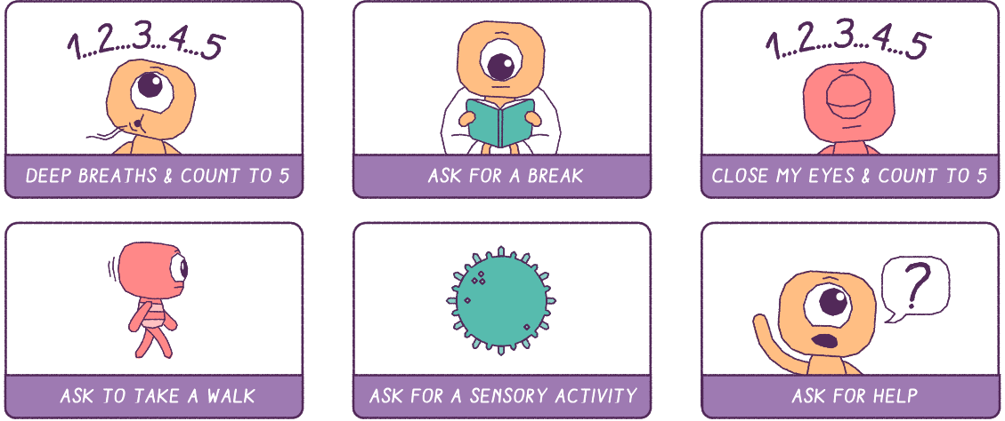
How can we manage our emotions?
15

Slide 16
This is the end of Lesson 2.
Great work!

